Slide 1
Continuous Delivery
Prof. Dr. Dirk Riehle
Friedrich-Alexander University Erlangen-Nürnberg
AMOS F02
Licensed under CC BY 4.0 International
Notes:
It is Friedrich-Alexander University Erlangen-Nürnberg – FAU, in short.
Corporate identity wants us to say “Friedrich-Alexander University”.

Slide 2
Beginner’s Development Cycle
edit
Developer
  Edit: Implements new feature
    Iterates over the code until it looks right
  Compile: Compiles the code
    Iterates over the code until it compiles (no syntax error)
  Build: Puts classes, build path together
    Packages jar, if any, by hand
  Test: Tests the program
    Keeps going until “behavior looks right” i.e. no bugs
  Deploy: Puts code into production
    If a student, submits homework
compile
build
test
deploy

Slide 3
Practitioner’s Development Cycle
Developer
Environment
Production
System
Developer
  Finishes development work
    Uses local edit-compile-test cycle
    Commits to indicate finishing
  Builds for production environment
    Could possibly use local build
  Deploys to production system
edit
compile
build
build
deploy
deploy
test
commit
operate

Slide 4
Professional Development Cycle
Developer
Environment
Test
System
Production
System
QA engineer
  Fetches code
  Builds full system
    Deploys in test system
  Tests full system
    Automated and by-hand
      Component tests
      Acceptance
      Integration tests
  Deploys full system
  Operates system
edit
compile
fetch
fetch
build
build
build
deploy
deploy
deploy
test
test
monitor
commit
release
operate

Slide 5
Continuous Integration Development Cycle
Developer
Environment
Test
System
Production
System
Release (QA) engineer
  Fetches code
  Builds full system
    Deploys in test system
  Tests full system
    Automated and by-hand
      Component tests
      Acceptance
      Integration tests
  Deploys full system
  Operates system
edit
compile
fetch
fetch
build
build
build
deploy
deploy
deploy
test
test
monitor
test automation
commit
release
operate

Slide 6
Test Automation
Test automation ...
  automatically carries out all available tests
    Component tests (unit tests)
    Acceptance tests (functional tests)
    Integration tests and system tests
  provides feedback to development and QA

Slide 7
Continuous Integration
Continuous integration (CI) is a code integration process
  Upon trigger (commit to official repository)
    the system under construction is fetched, built, deployed, and tested
    in a fully automated way (no human intervention)
  Feedback upon system status is provided to both
    developers and
    managers
The purpose of continuous integration is to
  always know where you are standing with respect to the project
  ideally improve quality such that you can deploy at any time
Continuous integration requires test-driven development

Slide 8
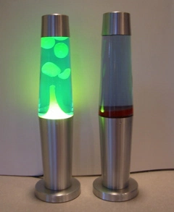
Continuous Integration and Lava Lamps
In the early days, lava lamps were used to signal whether the project could be deployed to production or not.

Slide 9
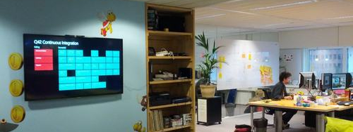
Continuous Integration Dashboards
Continuous integration quickly evolved to build and test status dashboards hung on office walls for everyone to see.

Slide 10
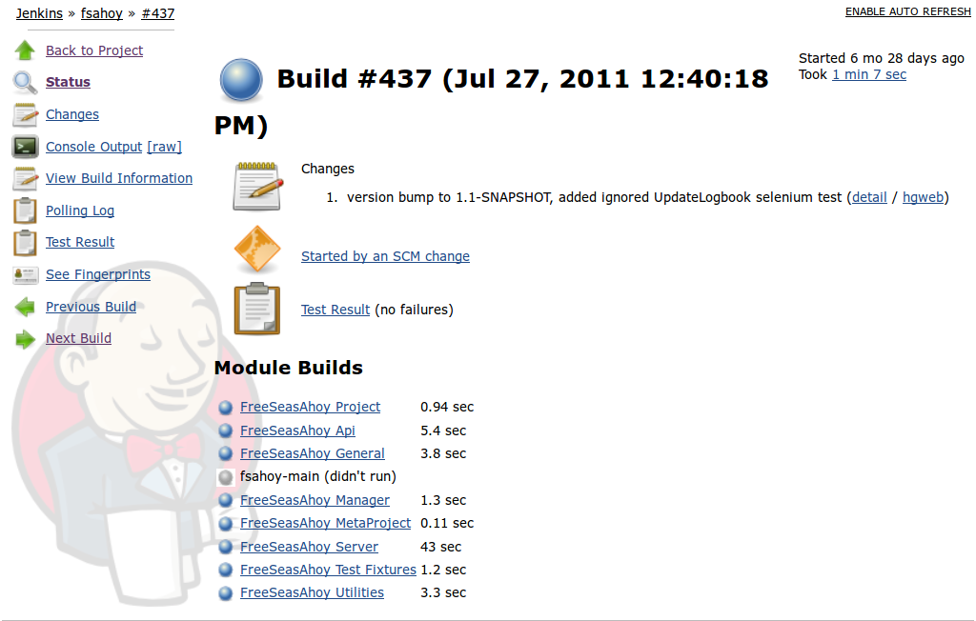
Example Dashboard Build #437

Slide 11
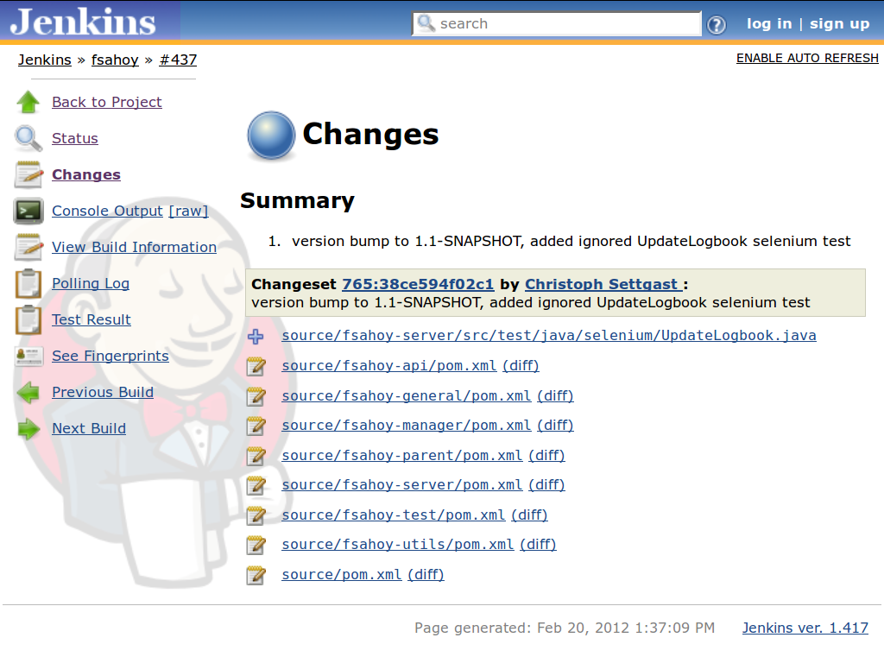
Example Dashboard Changes #437

Slide 12
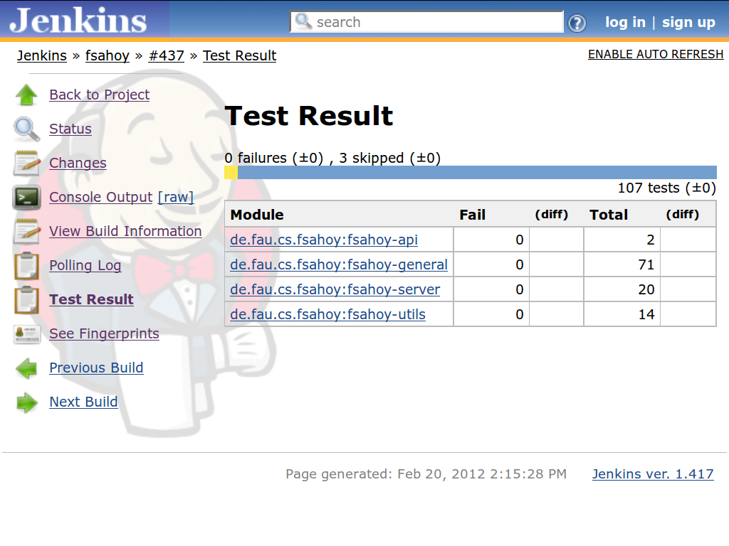
Example Dashboard Test Results #437

Slide 13
Continuous Deployment Development Cycle
Developer
Environment
Test
System
Production
System
Fully automated
  Compile and build
  Deployment
    To test environment
    To production
  Test execution
Partially automated
  System monitoring
  Automated rollback
Human decisions
  Commit decision
No release decision
edit
compile
fetch
fetch
build
build
build
deploy
deploy
deploy
Fully automated
test
test
monitor
commit
release
operate

Slide 14
Continuous Delivery
Continuous delivery is a delivery process
  Upon trigger (commit to official repository)
    the system is integrated, tested, and deployed to production
    in a fully automated way (no human intervention)
  A poorly functioning system may be rolled back
    Requires monitoring and rollback facility of deployed system
    System status is assessed using key figures
The purpose of continuous delivery is to
  put development results into production as fast as possible
  improve quality by holding the team to high operational standards

Slide 15
Continuous Delivery 1 / 2
Test automation
Continuous integration
Continuous deployment [1]
[1] Short for “development operations”

Slide 16
Continuous Delivery 2 / 2
Test automation =
  Tests and testing
Continuous integration =
  Test-driven development +
  Automated building +
  Test automation
Continuous deployment =
  Continuous integration +
  Deploy to production +
  Monitoring and rollback
DevOps
  Continuous deployment +
  Operations and culture

Slide 17
Review / Summary of Session
Continuous delivery
  Test automation
  Continuous integration
  Continuous deployment
  Development operations

Slide 18
Thank you! Questions?
dirk.riehle@fau.de – http://osr.cs.fau.de
dirk@riehle.org – http://dirkriehle.com – @dirkriehle
DR

Slide 19
Credits and License
Original version
  © 2012-2019 Dirk Riehle, some rights reserved
  Licensed under Creative Commons Attribution 4.0 International License
Contributions
  ...

